Slide 2
project group 11: Storm presentation
Robin Boudry -

Slide 3
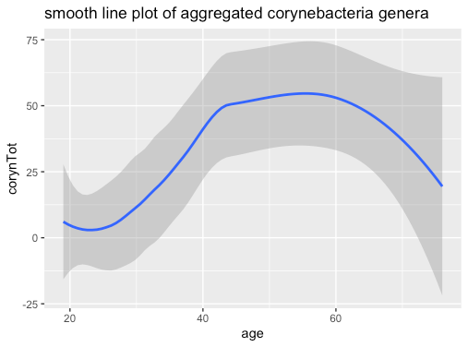
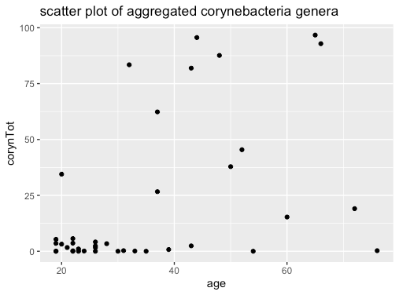
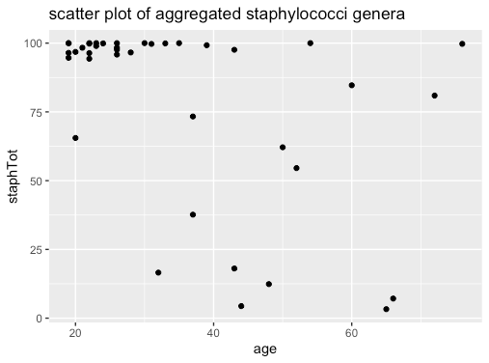
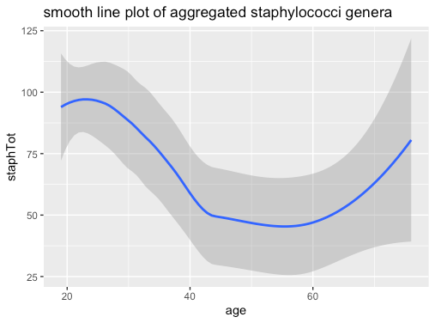
Genus Composition vs Age as Continuous

Slide 4
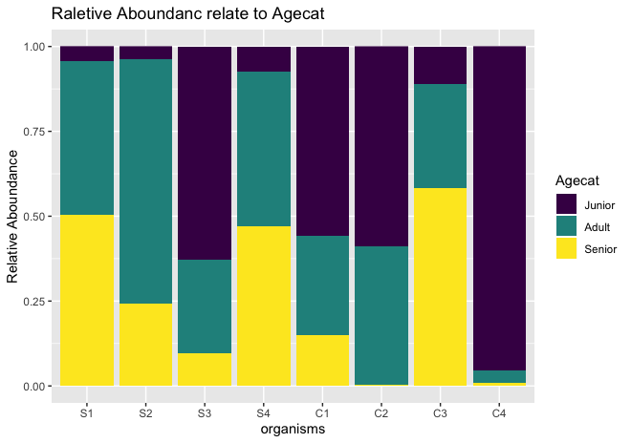
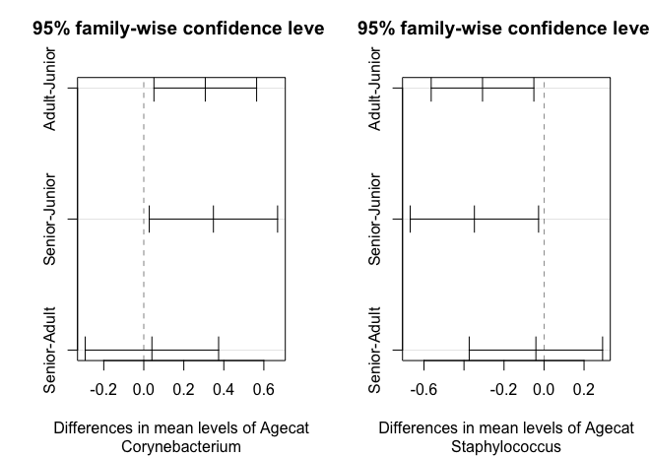
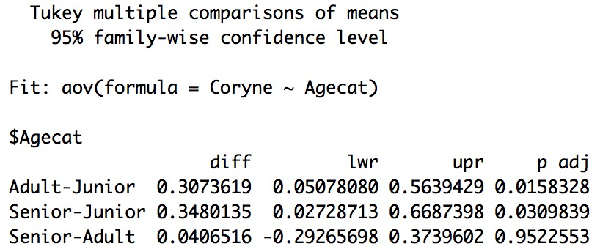
genus composition among agecat
Hypothesis
H0: genus composition don’t change with age
Ha: genus composition change with age
Discrete age to agecat
Junior: <= 26
Adult: 27<= x<= 50
Senior: >=51
View the relative abundances among agecat
Multiple comparisons
Group the relative abundances by Corynebacterium and Staphylococcus
Statistics

Slide 5
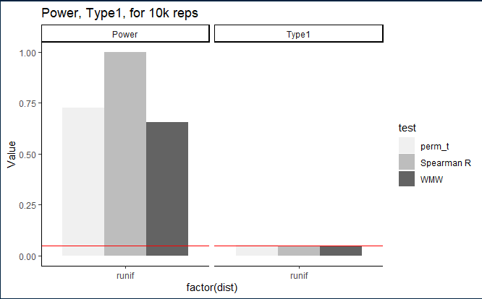
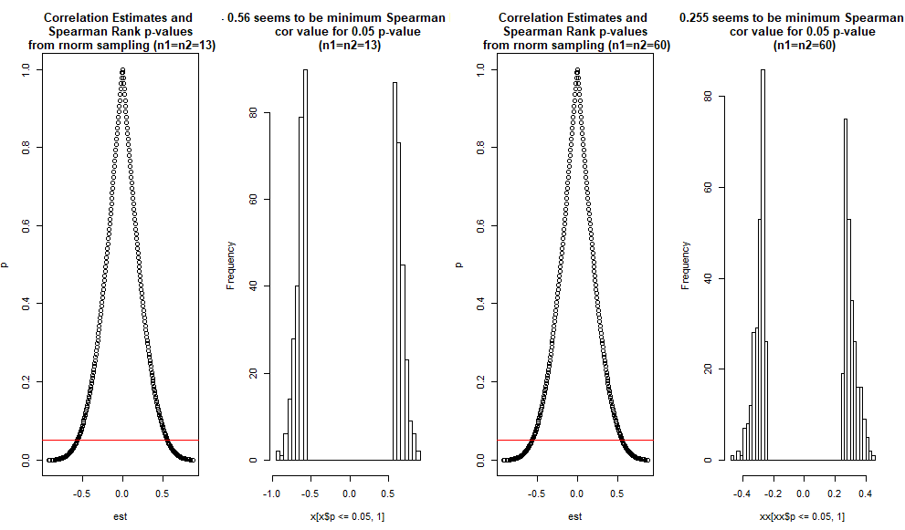
In search of a non parametric association test
Spearman Rank Cor Test:
“Spearman's rho statistic is used to estimate a rank-based measure of association. To be used if the data does not necessarily come from a bivariate normal distribution.” Seeing our small sample, this seems like a good option for our problem.
In R: “cor.test(x, y, method=“Spearman")”
Glance at Type1 & Power: Graph1
Glance at effect of sample size on the test: Graph2
Graph1
Graph2
Notes:
RB: Here I introduce the Spearman rank cor test, together with its properties. (30sec)

Slide 6
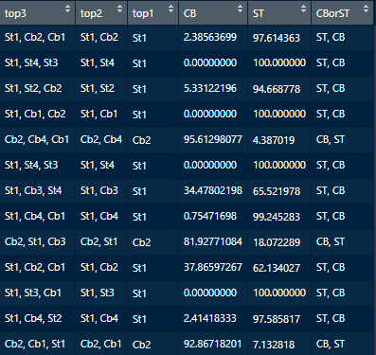
Analysing relative frequencies
8 variables summing to 100 2 creative ideas:
Aggregate per type
‘Dominant’ order
Allows easier comparison with age.
Notes:
RB: Here I propose the data transformations Merton will use for the next question (20sec)

Slide 7
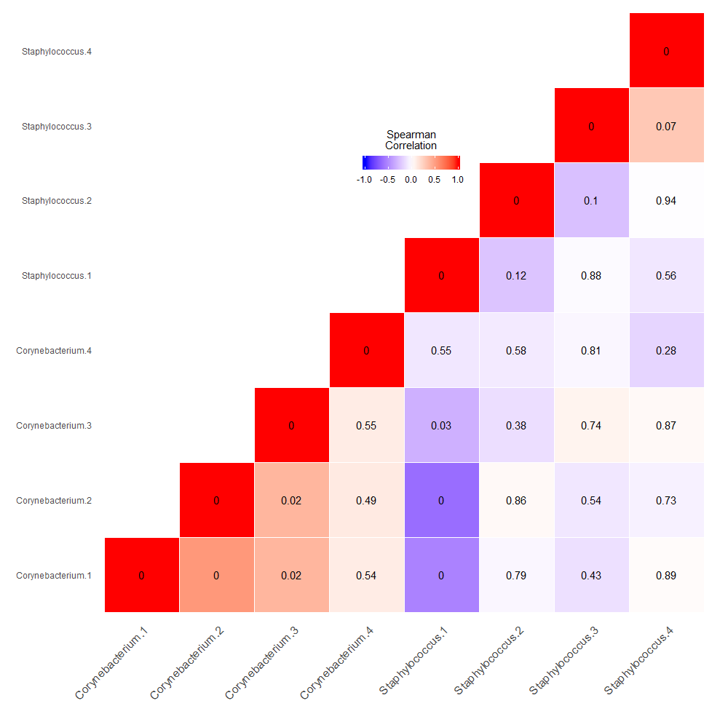
Relation between relative abundances
Use Spearman Rho rank test
Take into account multiple testing problem

Slide 8


Holms bonferroni vs Benjamini–Yekutieli

Slide 9
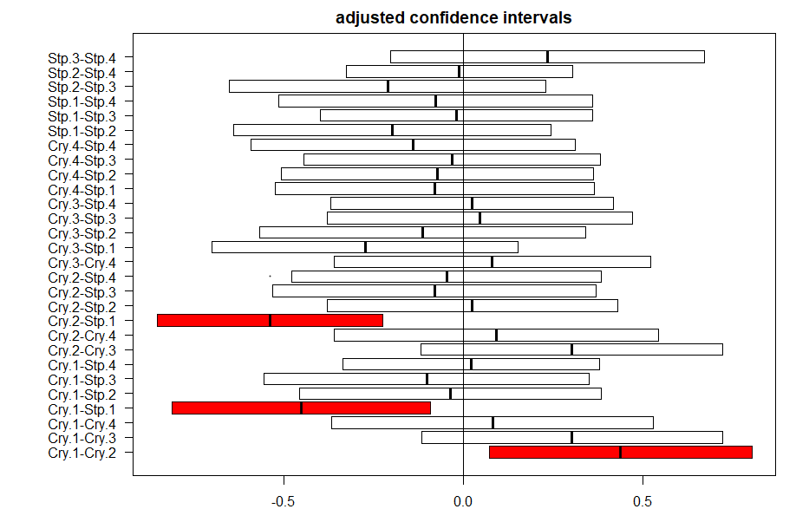
Confidence intervals

Slide 10




www.ugent.be
Universiteit Gent @ugent
@ugent Ghent University

